Slide 1

Notes:
1st slide (Mandatory)

Slide 2

Calculate Time Complexity
How To
O(n^2)
Operations
O (n log n)
O (n^2)
O(n)
Elements

Slide 3

What is Time Complexity?
Topic/Course
You can get the time complexity by “counting” the number of operations performed by your code.
This time complexity is defined as a function of the input size n using Big-O notation. n indicates the input size, while O is the worst-case scenario growth rate function.
We use the Big-O notation to classify algorithms based on their running time or space (memory used) as the input grows.
The O function is the growth rate in function of the input size n.
Notes:
Big O notation is a mathematical notation used to describe the asymptotic behavior of a function as its input grows arbitrarily large. In computer science, it is used to describe the time complexity of an algorithm, which is a measure of the amount of time an algorithm takes to run as a function of the size of its input.
Time complexity is often expressed using Big O notation. It describes the upper bound on the running time of an algorithm in terms of the input size. The Big O notation provides a way to compare the efficiency of different algorithms and to choose the best one for a particular problem.
The time complexity of an algorithm is affected by various factors such as the size of the input data, the type of operations performed, and the algorithm design. It is important to analyze the time complexity of an algorithm to ensure that it can handle large inputs efficiently and to avoid scalability issues.

Slide 4
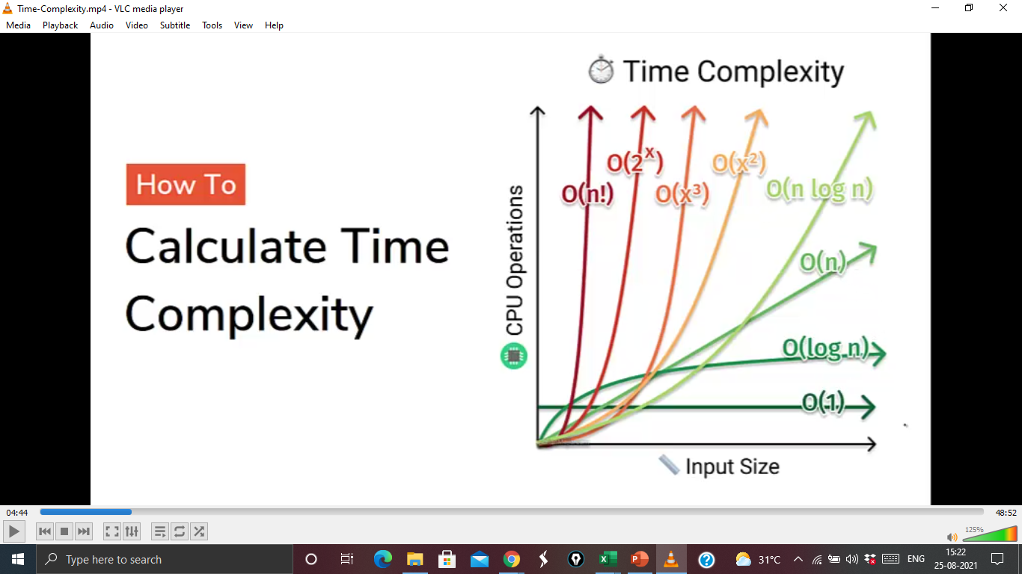
Calculate Time Complexity
How To
O(n^2)
Operations
O (n log n)
O (n^2)
O(n)
Elements
Notes:
A time complexity chart is a graphical representation of the time complexity of an algorithm as a function of its input size. It plots the time taken by the algorithm on the y-axis against the input size on the x-axis.
The chart usually shows several curves representing different time complexity classes of algorithms. The most commonly used time complexity classes are:
1. Constant time (O(1)): An algorithm is said to have constant time complexity if its running time is independent of the input size. In a time complexity chart, the curve for constant time complexity would be a horizontal line.
2. Linear time (O(n)): An algorithm is said to have linear time complexity if its running time increases linearly with the input size. In a time complexity chart, the curve for linear time complexity would be a straight line that rises at a constant rate.
3. Logarithmic time (O(log n)): An algorithm is said to have logarithmic time complexity if its running time increases logarithmically with the input size. In a time complexity chart, the curve for logarithmic time complexity would be a gently rising curve that flattens out as the input size increases.
4. Quadratic time (O(n^2)): An algorithm is said to have quadratic time complexity if its running time increases exponentially with the input size. In a time complexity chart, the curve for quadratic time complexity would be a parabolic curve that rises steeply as the input size increases.
5. Exponential time (O(2^n)): An algorithm is said to have exponential time complexity if its running time increases exponentially with the input size. In a time complexity chart, the curve for exponential time complexity would be a steeply rising curve that quickly becomes almost vertical.
By analyzing the time complexity chart of an algorithm, we can get an idea of how efficient it is and how it will perform on different input sizes. We can also compare the time complexity of different algorithms to choose the most efficient one for a particular problem.

Slide 5
Big O Cheatsheet
Big O Notation | Name | Examples
O(1) | Constant | Odd or Even number
O(log n) | Logarithmic | Finding element on sorted array with binary search
O(n) | Linear | Find max element in unsorted array
O(n log n) | Linearithmic | Sorting elements in array with merge sort
O(n²) | Quadratic | Sorting array with bubble sort
O(n³) | Cubic | 3 variables equation solver
O(2^{n}) | Exponential | Find all subsets
O(n!) | Factorial | Find all permutations of a given set/string
Topic/Course

Slide 6
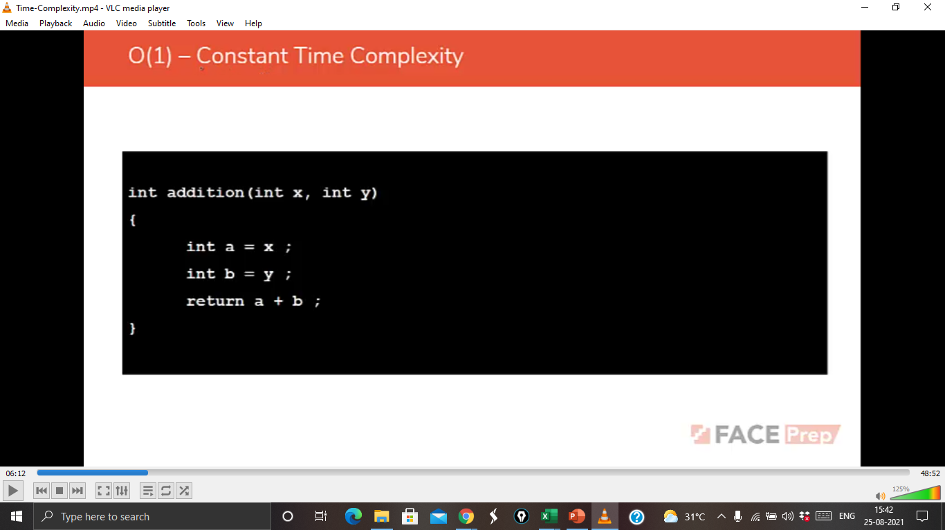
Notes:
O(1) is a time complexity class used to describe algorithms that take a constant amount of time to execute, regardless of the input size. In other words, the running time of an algorithm with O(1) time complexity does not depend on the size of the input data.
Examples of algorithms that have O(1) time complexity include:
1. Accessing an element in an array or a dictionary by its index or key. This operation takes constant time because the index or key can be used to directly access the element in memory.
2. Performing a simple arithmetic operation such as addition or multiplication. These operations take constant time because they are executed in a fixed number of CPU cycles.
3. Pushing or popping an item from the top of a stack. These operations take constant time because they involve only one element and do not depend on the size of the stack.
An algorithm with O(1) time complexity is considered highly efficient because it can process large amounts of data in constant time. However, it is not always possible to design an algorithm with O(1) time complexity for a given problem. In some cases, the best time complexity that can be achieved is O(n) or higher.

Slide 7
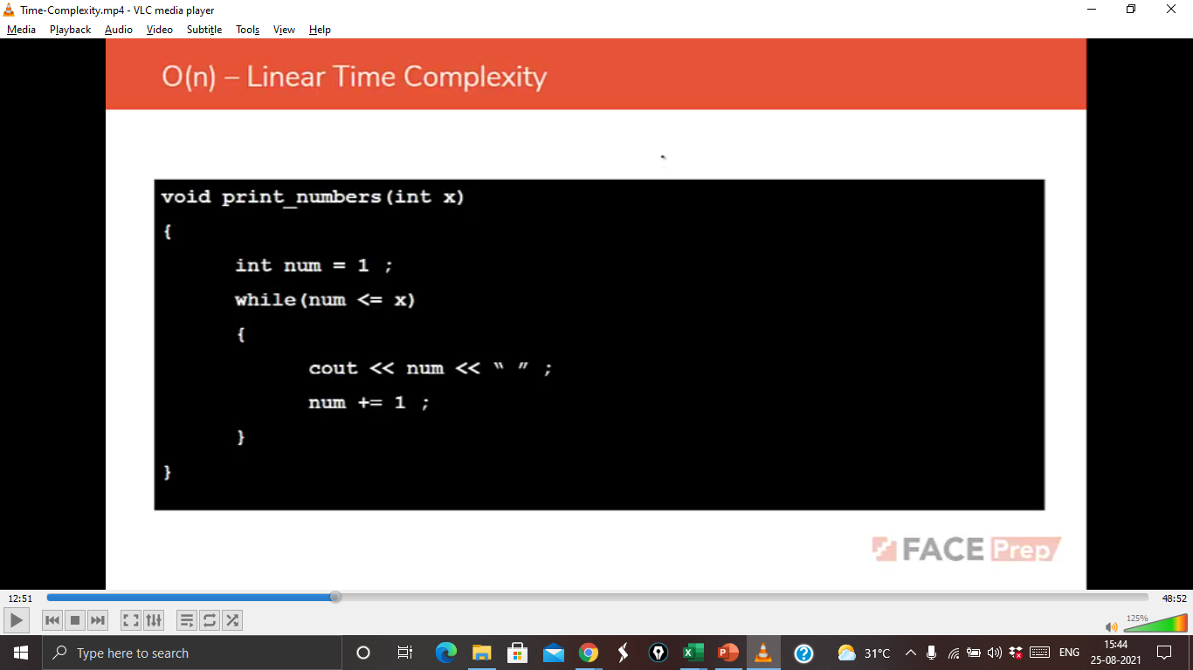
Notes:
O(n) is a time complexity class used to describe algorithms that have a running time proportional to the size of the input data. In other words, an algorithm with O(n) time complexity will take n units of time to execute if the input size is n.
Examples of algorithms that have O(n) time complexity include:
1. Traversing an array or a linked list. This operation takes O(n) time because it requires visiting each element in the list once.
2. Searching for an element in an unsorted array or a linked list. This operation takes O(n) time in the worst case because the element may be located at the end of the list.
3. Computing the sum of all elements in an array. This operation takes O(n) time because it requires adding up all the elements in the array.
An algorithm with O(n) time complexity is considered moderately efficient because it can handle moderate-sized input data in a reasonable amount of time. However, if the input size is very large, the algorithm may take too long to run. In such cases, we may need to use an algorithm with a better time complexity, such as O(log n) or O(1), if possible.

Slide 8
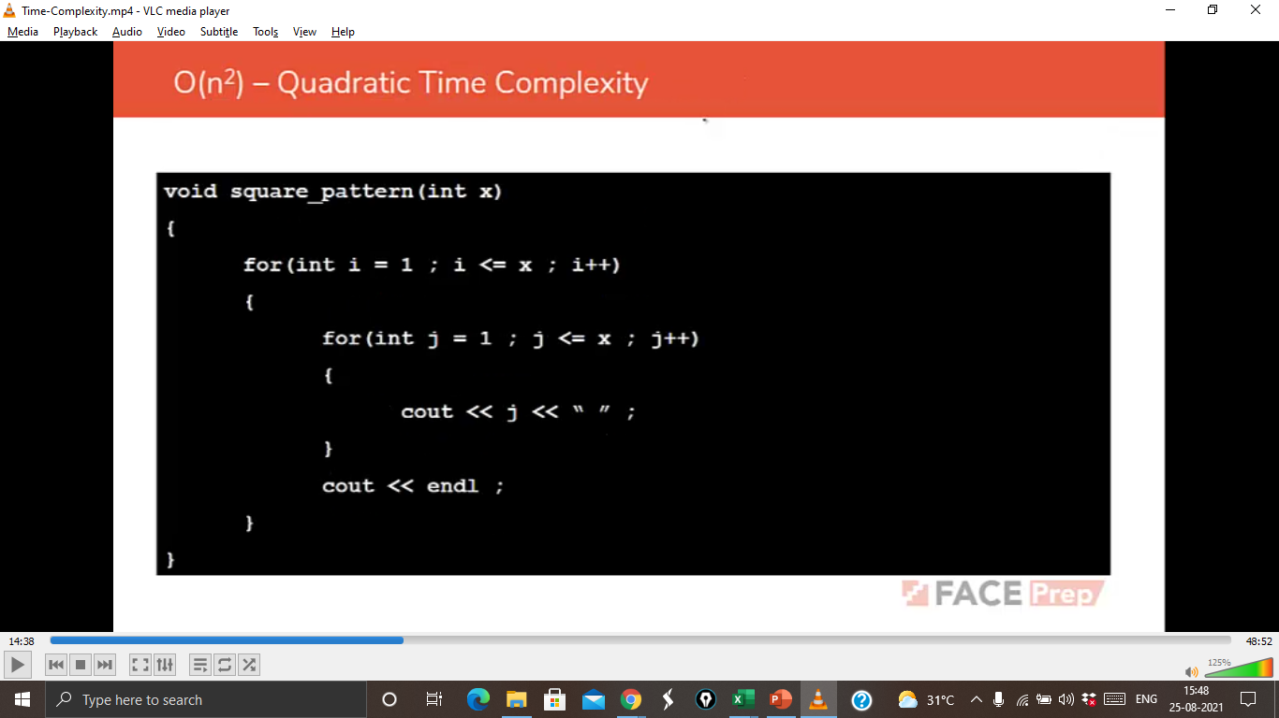
Notes:
O(n^2) is a time complexity class used to describe algorithms that have a running time proportional to the square of the input size. In other words, an algorithm with O(n^2) time complexity will take n^2 units of time to execute if the input size is n.
Examples of algorithms that have O(n^2) time complexity include:
1. Bubble sort algorithm. This sorting algorithm has a time complexity of O(n^2) because it requires comparing each pair of adjacent elements and swapping them if they are in the wrong order, and it needs to repeat this process n times to fully sort the array.
2. Selection sort algorithm. This sorting algorithm also has a time complexity of O(n^2) because it requires repeatedly finding the minimum element in the unsorted part of the array and swapping it with the first element, and it needs to repeat this process n times to fully sort the array.
3. Computing the product of all pairs of elements in an array. This operation takes O(n^2) time because it requires computing the product of each pair of elements in the array.
An algorithm with O(n^2) time complexity is considered relatively inefficient because it can take a long time to run for large input sizes. For example, if the input size is 1000, the algorithm may need to perform 1 million operations, which can take a significant amount of time. Therefore, it is generally not recommended to use O(n^2) algorithms for large input sizes.

Slide 9
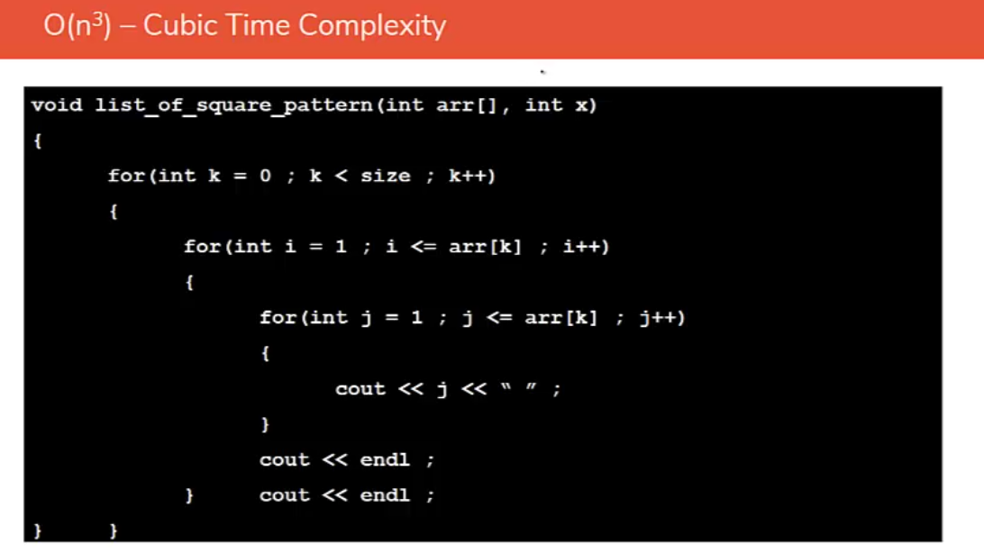
Notes:
O(n^3) is a time complexity class used to describe algorithms that have a running time proportional to the cube of the input size. In other words, an algorithm with O(n^3) time complexity will take n^3 units of time to execute if the input size is n.
Examples of algorithms that have O(n^3) time complexity include:
1. Matrix multiplication. Computing the product of two n x n matrices using the standard matrix multiplication algorithm takes O(n^3) time because it requires n^3 scalar multiplications.
2. Computing the sum of all triples of elements in an array. This operation takes O(n^3) time because it requires computing the sum of each possible triple of elements in the array.
3. Nested loops with three levels. If an algorithm has three nested loops that each iterate n times, the total number of iterations will be n^3, resulting in a time complexity of O(n^3).
An algorithm with O(n^3) time complexity is considered relatively inefficient because it can take a very long time to run for large input sizes. For example, if the input size is 100, the algorithm may need to perform 1 million operations, and for an input size of 1000, it may need to perform 1 billion operations. Therefore, it is generally not recommended to use O(n^3) algorithms for large input sizes, unless it is absolutely necessary.

Slide 10
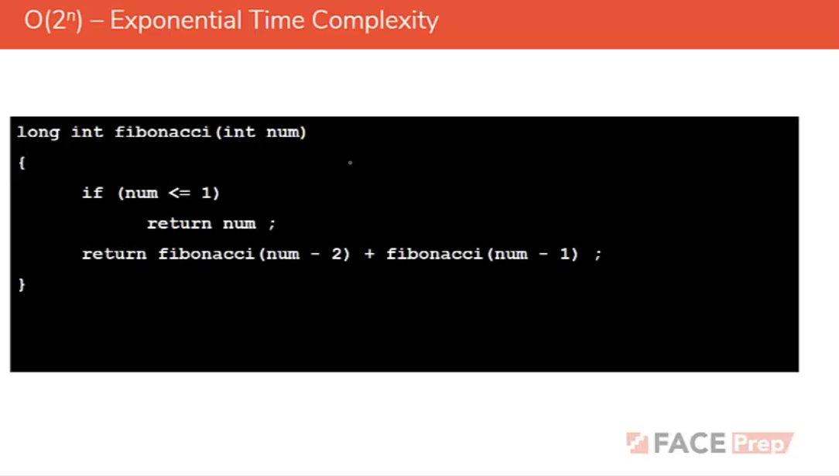
Notes:
O(2^n) is a time complexity class used to describe algorithms that have a running time that grows exponentially with the input size. In other words, an algorithm with O(2^n) time’Wwwwww00za0 complexity will take 2^n units of time to execute if the input size is n.
Examples of algorithms that have O(2^n) time complexity include:
1. Computing all subsets of a set. This operation takes O(2^n) time because there are 2^n possible subsets of a set with n elements.
2. Computing the Fibonacci sequence using a recursive algorithm. The running time of the recursive algorithm is O(2^n) because it generates a binary tree with 2^n nodes, and each node corresponds to a call to the Fibonacci function.
3. Solving the traveling salesman problem using brute force. The brute force algorithm for the traveling salesman problem has a time complexity of O(n^2 * 2^n) because it needs to examine all possible tours, which is of the order of 2^n, and for each tour, it needs to examine all n possible starting points and visit all n-1 remaining cities.
An algorithm with O(2^n) time complexity is considered highly inefficient because it can take an impractical amount of time to run for even moderately large input sizes. For example, if the input size is 20, the algorithm may need to perform over one million operations, and for an input size of 30, it may need to perform over one billion operations. Therefore, it is generally not recommended to use O(2^n) algorithms for large input sizes.

Slide 11
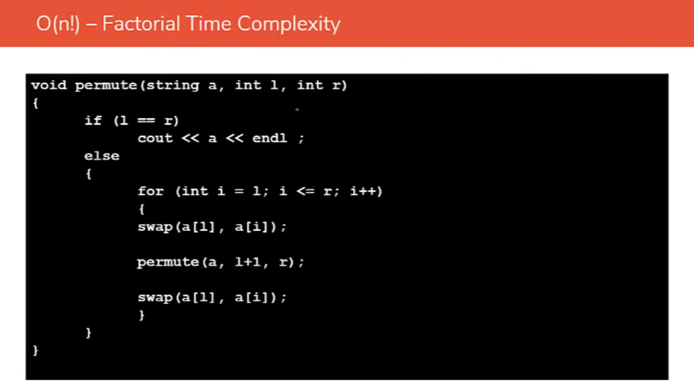
Notes:
O(n!) is a time complexity class used to describe algorithms that have a running time that grows factorial with the input size. In other words, an algorithm with O(n!) time complexity will take n! units of time to execute if the input size is n.
Examples of algorithms that have O(n!) time complexity include:
1. Solving the traveling salesman problem using brute force. The brute force algorithm for the traveling salesman problem has a time complexity of O(n!), because it needs to examine all possible tours, which is of the order of n! (n factorial).
2. Generating all permutations of a sequence. This operation takes O(n!) time because there are n! possible permutations of a sequence with n elements.
3. Solving the eight queens problem using brute force. The brute force algorithm for the eight queens problem has a time complexity of O(n!), because it needs to examine all possible arrangements of the queens on the chessboard, which is of the order of n! (n factorial).
An algorithm with O(n!) time complexity is considered extremely inefficient because it can take an astronomical amount of time to run for even moderately large input sizes. For example, if the input size is 10, the algorithm may need to perform over 3.6 million operations, and for an input size of 20, it may need to perform over 2.4 trillion operations. Therefore, it is generally not recommended to use O(n!) algorithms for large input sizes, unless it is absolutely necessary.

Slide 12
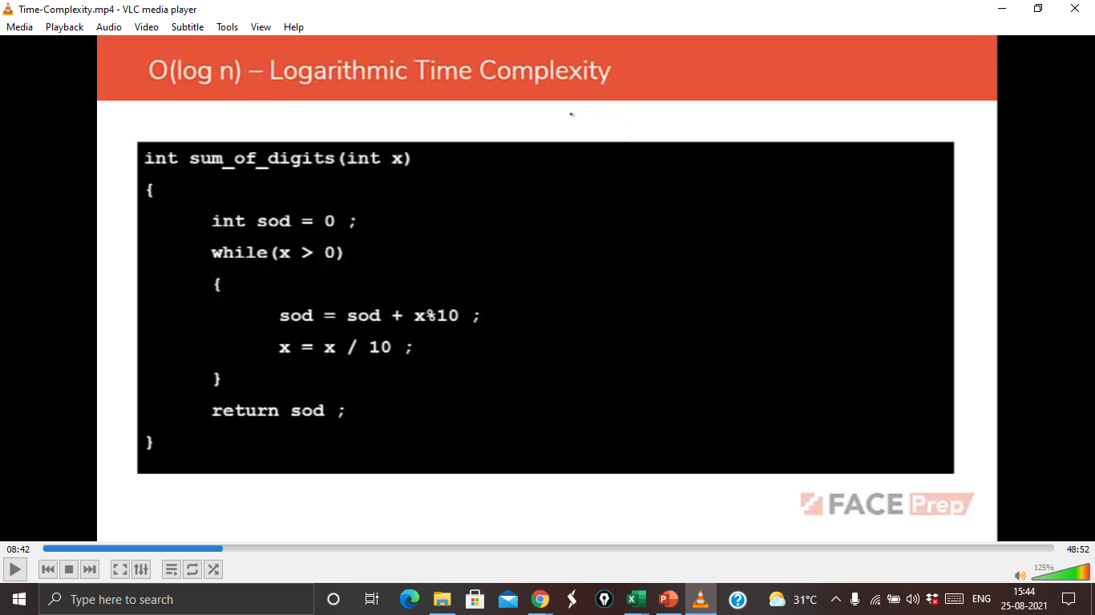
Notes:
O(log n) is a time complexity class used to describe algorithms that have a running time proportional to the logarithm of the input size. In other words, an algorithm with O(log n) time complexity will take log n units of time to execute if the input size is n.
Examples of algorithms that have O(log n) time complexity include:
1. Binary search. In an ordered list of n items, binary search takes O(log n) time to find a specific item because it eliminates half of the remaining items with each comparison.
2. Finding the largest or smallest element in a sorted array. This operation can be performed in O(log n) time using binary search.
3. Finding the height of a balanced binary search tree. The height of a balanced binary search tree with n nodes is O(log n).
An algorithm with O(log n) time complexity is considered very efficient because it can handle very large input sizes with reasonable time complexity. For example, if the input size is 1 billion, the algorithm may only need to perform about 30 operations, which is very fast. Therefore, O(log n) algorithms are often preferred over algorithms with higher time complexities for large-scale data processing and optimization problems.

Slide 13
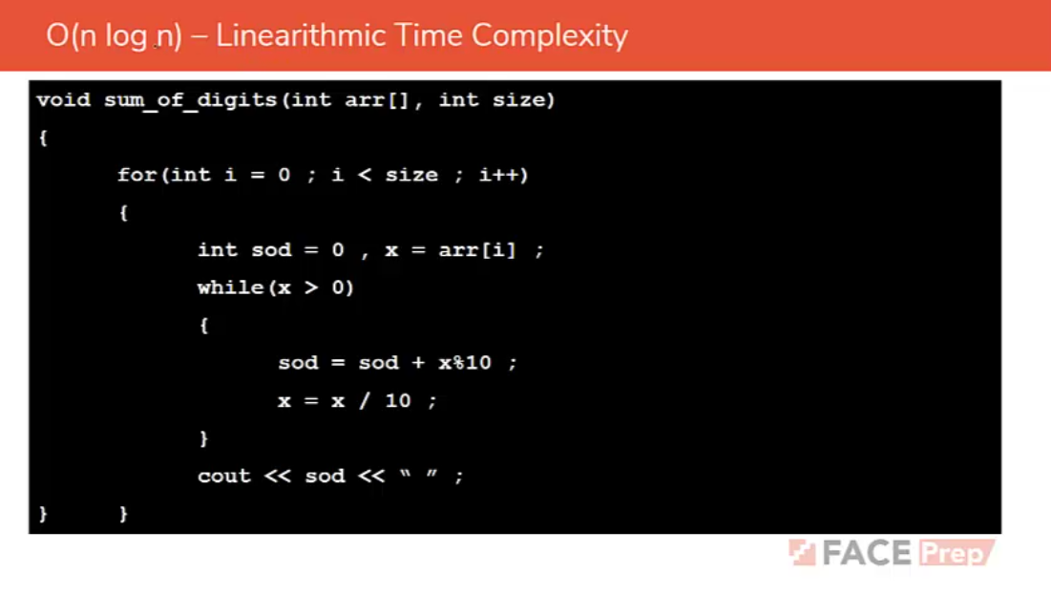
Notes:
O(n log n) is a time complexity class used to describe algorithms that have a running time proportional to n times the logarithm of n. In other words, an algorithm with O(n log n) time complexity will take n log n units of time to execute if the input size is n.
Examples of algorithms that have O(n log n) time complexity include:
1. Merge sort. Merge sort is a divide-and-conquer sorting algorithm that has a time complexity of O(n log n) because it divides the input into smaller subproblems and combines them in a way that takes n log n units of time.
2. Quicksort. Quicksort is another divide-and-conquer sorting algorithm that has an average time complexity of O(n log n). It partitions the input array based on a pivot element and then sorts the two resulting subarrays recursively.
3. Heap sort. Heap sort is a comparison-based sorting algorithm that has a time complexity of O(n log n). It uses a binary heap data structure to sort the input array in place.
An algorithm with O(n log n) time complexity is considered very efficient for large input sizes. For example, if the input size is 1 million, the algorithm may only need to perform about 20 million operations, which is still relatively fast. Therefore, O(n log n) algorithms are commonly used in various applications that require efficient sorting or searching, such as database management, data mining, and computational biology.

Slide 14
Predict the time complexity for the given below code snippet
int fun()
{
for(i = 1; i < n; i++)
{
cout << “FACE PREP”;
}
return 0;
}
A) O(n)
B) O(log n)
C) O (sqrt n)
D) O(n * n)
Notes:
A)O(n)
The given code snippet has a for loop that iterates from 1 to n-1 and prints "FACE PREP" to the console on each iteration. Since the loop only performs a constant amount of work on each iteration, the time complexity of the loop is O(n), where n is the input size.
Therefore, the time complexity of the entire function is also O(n), because the for loop is the only significant operation in the function. The return statement is a constant time operation and has no effect on the time complexity.
In other words, this function takes time proportional to the input size, and is considered a linear time algorithm.

Slide 15
Predict the time complexity for the given below code snippet
int fun()
{
for(i = 1; i <= sqrt(n); i++)
{
cout << “FACE PREP”;
}
return 0;
}
A) O(n)
B) O(log n)
C) O (sqrt n)
D) O(n * n)
Notes:
C)O(sqrt n)
The given code snippet has a for loop that iterates from 1 to the square root of n and prints "FACE PREP" to the console on each iteration. Since the loop iterates for sqrt(n) times, the time complexity of the loop is O(sqrt(n)).
Therefore, the time complexity of the entire function is O(sqrt(n)), because the for loop is the only significant operation in the function. The return statement is a constant time operation and has no effect on the time complexity.
In other words, this function takes time proportional to the square root of the input size, and is considered a sublinear time algorithm. The time complexity grows much slower than linear algorithms, and is often desirable in practice.

Slide 16
Predict the time complexity for the given below code snippet
int fun()
{
for(i = 1; i*i <= n; i++)
{
cout << “FACE PREP”;
}
return 0;
}
A) O(n)
B) O(log n)
C) O (sqrt n)
D) O(n * n)
Notes:
C) O (sqrt n)
The given code snippet has a for loop that iterates from 1 until i^2 becomes greater than n, and prints "FACE PREP" to the console on each iteration. Since the loop iterates for i times where i satisfies the condition i^2 <= n, the number of iterations is proportional to the square root of n. Therefore, the time complexity of the loop is O(sqrt(n)).
To see why, note that the largest value of i that satisfies i^2 <= n is the square root of n. Hence, the loop runs for at most sqrt(n) iterations.
Therefore, the time complexity of the entire function is O(sqrt(n)), because the for loop is the only significant operation in the function. The return statement is a constant time operation and has no effect on the time complexity.
In other words, this function takes time proportional to the square root of the input size, and is considered a sublinear time algorithm. The time complexity grows much slower than linear algorithms, and is often desirable in practice.

Slide 17
Predict the time complexity for the given below code snippet
int fun()
{
for(i = 1; i <= n; i=i*2)
{
cout << “FACE PREP”;
}
return 0;
}
A) O(n)
B) O(log n)
C) O (sqrt n)
D) O(n * n)
Notes:
B) O(log n)
The given code snippet has a for loop that iterates from 1 to n, doubling i on each iteration, and prints "FACE PREP" to the console on each iteration. Since the loop doubles the value of i on each iteration, the number of iterations is proportional to the logarithm of n to the base 2. Therefore, the time complexity of the loop is O(log n).
Therefore, the time complexity of the entire function is O(log n), because the for loop is the only significant operation in the function. The return statement is a constant time operation and has no effect on the time complexity.
In other words, this function takes time proportional to the logarithm of the input size, and is considered a logarithmic time algorithm. The time complexity grows very slowly as the input size increases, and is often very efficient in practice.

Slide 18
Predict the time complexity for the given below code snippet
int fun()
{
int n;
while(n > 1)
{
n = n / 2;
}
return 0;
}
A) O(n)
B) O(log n)
C) O (sqrt n)
D) O(n * n)
Notes:
B) O(log n)
The given code snippet has a while loop that repeatedly divides n by 2 until n becomes less than or equal to 1. Since the loop divides n by 2 on each iteration, the number of iterations is proportional to the logarithm of n to the base 2. Therefore, the time complexity of the loop is O(log n).
Therefore, the time complexity of the entire function is O(log n), because the while loop is the only significant operation in the function. The return statement is a constant time operation and has no effect on the time complexity.
In other words, this function takes time proportional to the logarithm of the input size, and is considered a logarithmic time algorithm. The time complexity grows very slowly as the input size increases, and is often very efficient in practice.

Slide 19
Predict the time complexity for the given below code snippet
int fun()
{
for(i = 1; i < n; i++)
{
for(j = 1; j < n; j++)
{
cout << “FACE PREP”;
}
}
return 0;
}
A) O(n)
B) O(log n)
C) O (sqrt n)
D) O(n * n)
Notes:
D) O(n * n)
The given code snippet has two nested for loops that iterate from 1 to n-1, and print "FACE PREP" to the console on each iteration of the inner loop. The outer loop iterates n-1 times, and the inner loop iterates n-1 times for each iteration of the outer loop. Therefore, the total number of iterations of the inner loop is (n-1) * (n-1) = n^2 - 2n + 1.
Therefore, the time complexity of the nested loops is O(n^2), because the number of iterations is proportional to the square of the input size.
Therefore, the time complexity of the entire function is O(n^2), because the nested loops are the only significant operations in the function. The return statement is a constant time operation and has no effect on the time complexity.
In other words, this function takes time proportional to the square of the input size, and is considered a quadratic time algorithm. The time complexity grows quickly as the input size increases, and is often less efficient than linear or logarithmic time algorithms.

Slide 20
Predict the time complexity for the given below code snippet
int fun()
{
for(i = 1; i < n; i++)
{
for(j = 1; j < n; j++)
{
cout << “FACE PREP”;
break;
}
}
return 0;
}
A) O(n)
B) O(log n)
C) O (sqrt n)
D) O(n * n)
Notes:
O(n)
The given code snippet has two nested for loops that iterate from 1 to n-1, and print "FACE PREP" to the console on each iteration of the inner loop. However, the inner loop contains a `break` statement that will cause the inner loop to exit after the first iteration.
Therefore, the total number of iterations of the inner loop is always 1, regardless of the value of n. The outer loop iterates n-1 times, but the inner loop always runs only once for each iteration of the outer loop. Therefore, the total number of iterations of the inner loop is proportional to the input size n.
Therefore, the time complexity of the nested loops is O(n), because the number of iterations is proportional to the input size.
Therefore, the time complexity of the entire function is also O(n), because the nested loops are the only significant operations in the function. The return statement is a constant time operation and has no effect on the time complexity.
In other words, this function takes time proportional to the input size, and is considered a linear time algorithm. The time complexity grows linearly as the input size increases, and is often more efficient than quadratic or higher order algorithms.

Slide 21
Predict the time complexity for the given below code snippet
int fun()
{
for(i = 1; i < n; i++)
{
for(j = 1; j < n; j=j+i)
{
cout << “FACE PREP”;
}
}
return 0;
}
A) O(n)
B) O(log n)
C) O (n * log n)
D) O(n * n)
Notes:
C) O (n * log n)
The given code snippet has two nested for loops that iterate from 1 to n-1, and print "FACE PREP" to the console on each iteration of the inner loop. However, the inner loop has a step size of i instead of 1, so the inner loop iterates n/i times for each iteration of the outer loop.
The outer loop iterates n-1 times, and the inner loop iterates n/1, n/2, n/3, ..., n/(n-1) times for each iteration of the outer loop. Therefore, the total number of iterations of the inner loop can be computed as follows:
n/1 + n/2 + n/3 + ... + n/(n-1)
This series is called the harmonic series, and it grows logarithmically with the input size n. Specifically, the sum of the harmonic series is approximately equal to ln(n) + γ, where γ is the Euler-Mascheroni constant. Therefore, the time complexity of the nested loops is O(n log n), because the number of iterations grows logarithmically with the input size.
Therefore, the time complexity of the entire function is also O(n log n), because the nested loops are the only significant operations in the function. The return statement is a constant time operation and has no effect on the time complexity.
In other words, this function takes time proportional to the input size multiplied by the logarithm of the input size, and is considered a "nearly linear" time algorithm. The time complexity grows slower than a quadratic time algorithm but faster than a linear time algorithm, and is often efficient for medium-sized inputs.

Slide 22
Predict the time complexity for the given below code snippet
int fun()
{
int i, j;
for(i = 1; i < n; i++)
{
for(j = 1; j < n; j=j*2)
{
cout << “FACE PREP”;
}
}
return 0;
}
A) O(n)
B) O(log n)
C) O (n * log n)
D) O(n * n)
Notes:
C) O (n * log n)
The given code snippet has two nested for loops that iterate from 1 to n-1, and print "FACE PREP" to the console on each iteration of the inner loop. However, the inner loop has a step size of j*2 instead of 1, so the inner loop iterates log_2(n) times for each iteration of the outer loop.
The outer loop iterates n-1 times, and the inner loop iterates log_2(1), log_2(2), log_2(4), ..., log_2(2^(k-1)), where k is the largest integer such that 2^k <= n-1. Therefore, the total number of iterations of the inner loop can be computed as follows:
log_2(1) + log_2(2) + log_2(4) + ... + log_2(2^(k-1))
Using the identity log_2(x^y) = y*log_2(x), we can simplify this expression as follows:
log_2(1*2*4*...*2^(k-1)) = log_2(2^0 * 2^1 * 2^2 * ... * 2^(k-1)) = log_2(2^(0+1+2+...+(k-1))) = log_2(2^(k*(k-1)/2))
Since 2^(k*(k-1)/2) is approximately equal to n for large values of n, we can simplify the expression further as follows:
log_2(2^(k*(k-1)/2)) = k*(k-1)/2 = O(k^2)
Since k = floor(log_2(n-1)), the time complexity of the nested loops is O(log^2 n), because the number of iterations grows as the square of the logarithm of the input size.
Therefore, the time complexity of the entire function is also O(log^2 n), because the nested loops are the only significant operations in the function. The return statement is a constant time operation and has no effect on the time complexity.
In other words, this function takes time proportional to the logarithm of the input size squared, and is considered a "sublinear" time algorithm. The time complexity grows slower than a linear time algorithm but faster than a logarithmic time algorithm, and is often efficient for large inputs.

Slide 23
Predict the time complexity for the given below code snippet
int fun()
{
int i, j;
for(i = 1; i < n; i++)
{
for(j = n; j > 1; j--)
{
cout << “FACE PREP”;
}
}
}
A) O(n)
B) O(log n)
C) O (n * log n)
D) O(n * n)
Notes:
D) O(n * n)
There is a missing `return` statement at the end of the function. Adding that, the time complexity of the given code snippet is O(n^2).
The outer loop runs n times, and the inner loop also runs n times, so the total number of iterations will be n * n = n^2. As a result, the time complexity of the function is O(n^2).

Slide 24
Predict the time complexity for the given below code snippet
int fun()
{
int i, j, a = 0, b = 0;
for(i = 1; i < n; i++)
a = a + i;
for(j = 1; j < m; j++)
b = b + j;
return 0;
}
A) O(n)
B) O(m)
C) O (n + m)
D) O(n * m)
Notes:
C) O (n + m)
The given code snippet has a time complexity of O(n + m).
The first for loop runs n times, and the second for loop runs m times. The total number of iterations is equal to the sum of the two loops, i.e., n + m.
As a result, the time complexity of the function is O(n + m).

Slide 25
Predict the time complexity for the given below code snippet
for(i = 1; i <= n; i++)
{
for(j = 1; j <= i; j++)
{
for(k = 1; k <= 20; k++)
{
cout << “FACE PREP”;
}
}
}
A) O(n)
B) O(log n)
C) O (sqrt n)
D) O(n * n)
Notes:
D) O(n * n)
The given code snippet has a time complexity of O(n^2).
The outermost for loop runs n times. For each iteration of the outer loop, the inner for loop runs i times. Within the inner for loop, the innermost loop runs 20 times.
So, the total number of iterations will be the sum of 20 + 40 + 60 + ... + 20n, which can be simplified to 20(1 + 2 + 3 + ... + n). The sum of integers from 1 to n can be expressed as n(n+1)/2, so the total number of iterations will be 20(n(n+1)/2), which simplifies to 10n(n+1).
Therefore, the time complexity of the function is O(n^2).

Slide 26
Predict the time complexity for the given below code snippet
for(i = 1; i <= n; i++)
{
for(j = 1; j <= i*i; j++)
{
for(k = 1; k <= (n/2); k++)
{
cout << “FACE PREP”;
}
}
}
A) O(n)
B) O(n ^ 2)
C) O (n ^ 3)
D) O(n ^ 4)
Notes:
D) O(n ^ 4)
The time complexity of this code snippet can be calculated as follows:
- The outer loop runs for n iterations
- The second loop runs for i^2 iterations
- The innermost loop runs for n/2 iterations
Therefore, the total number of iterations of the innermost loop will be:
1 + 4 + 9 + ... + n^2
This is equivalent to the sum of the first n perfect squares, which can be approximated as (n^3)/3.
Therefore, the time complexity of the code snippet is O(n^3).

Slide 27
Predict the time complexity for the given below code snippet
for(i = n/2; i >=1; i--)
{
for(j = 1; j <= n; j=j*2)
{
for(k = 1; k <= n; k=k*2)
{
cout << “FACE PREP”;
}
}
}
A) O(n)
B) O(n * n)
C) O (sqrt n)
D) O(n*(log n)^2)
Notes:
D) O(n*(log n)^2)
The time complexity of this code snippet is O(n log n log n), which is a slightly improved version of O(n^2 log n).
The outer loop runs n/2 times, and the inner loop runs log_2(n) times because j is doubled at each iteration. Similarly, the innermost loop also runs log_2(n) times because k is doubled at each iteration. Hence the overall time complexity can be calculated as:
(n/2) * log_2(n) * log_2(n)
= (1/2) * n * log_2(n) * log_2(n)
= O(n log n log n)

Slide 28
Predict the time complexity for the given below code snippet
for(i = n/2; i <= n; i++)
{
for(j = 1; j +n/2<= n; j++)
{
for(k = 1; k <= n; k=k*2)
{
cout << “FACE PREP”;
}
}
}
A) O(n)
B) O(log n)
C) O (n * n)
D) O(n^2 (log n))
Notes:
D) O(n^2 (log n))
The time complexity of the given code snippet is O(n^2 * log n).
The outermost loop iterates from n/2 to n, so it will run n/2 times.
The middle loop iterates from 1 to n - n/2, so it will run n - n/2 times.
The innermost loop iterates from 1 to log n (base 2), so it will run log n times.
Therefore, the total number of iterations will be (n/2) * (n - n/2) * log n, which is equal to O(n^2 * log n).
Inside the innermost loop, a constant amount of work is done, which doesn't change the time complexity of the overall code snippet.

Slide 29
Predict the time complexity for the given below code snippet
int fun()
{
int n, ans = 0;
cin >> n;
while(n > 0)
{
ans += n % 10;
n /= 10;
}
return 0;
}
A) O(log₂ n)
B) O(log₃ n)
C) O(log₁₀ n)
D) O(n)
Notes:
C) O(log₁₀ n)
The given code calculates the sum of digits of a given number `n`. The time complexity of the code is proportional to the number of digits in `n`, which is `log(n)` in base 10. This is because the `while` loop executes once for each digit in `n`. Therefore, the time complexity of the code is `O(log n)`.

Slide 30
Predict the time complexity for the given below code snippet
for(i = n/2; i >=1; i--)
{
for(j = 1; j <= n/2; j++)
{
for(k = 1; k <= n; k=k*2)
{
cout << “FACE PREP”;
}
}
}
A) O(n)
B) O(log n)
C) O (n * n)
D) O(n^2 (log n))
Notes:
D) O(n^2 (log n))
The time complexity of the given code can be calculated as follows:
The outer for loop runs for n/2 times, so its time complexity is O(n).
The middle for loop runs for n/2 times for every iteration of the outer loop, so its time complexity is O(n).
The inner for loop runs for log_2(n) times for every iteration of the middle loop, so its time complexity is O(log n).
Therefore, the total time complexity of the code is O(n * n/2 * log n) = O(n^2 * log n).
So, the time complexity of the given code is quadratic with a logarithmic factor.

Slide 31
Predict the time complexity for the given below code snippet
int fun(int n)
{
if(n > 1)
return fun(n – 1);
}
A) O(n)
B) O(log n)
C) O (n * log n)
D) O(n * n)
Notes:
O(n)
The complexity of the function `fun()` is O(n), assuming that the `return` statement is meant to be followed by some code that is not shown. The function is recursively called with `n-1` until `n` becomes less than or equal to 1, which results in n recursive calls. Therefore, the time complexity of this function is O(n).

Slide 32
Predict the time complexity for the given below code snippet
int fun()
{
for(i = 1; i < n; i++)
{
for(j = 1; j < sqrt(n); j++)
{
cout << “FACE PREP”;
}
}
return 0;
}
A) O(n)
B) O(n * sqrt n)
C) O (n * log n)
D) O(n * n)
Notes:
B) O(n * sqrt n)
The time complexity of the given code is O(n * sqrt(n)), where n is the value of the variable 'n'. The outer loop runs for n-1 times, and the inner loop runs for sqrt(n) times. Therefore, the total number of times the innermost statement is executed is (n-1) * sqrt(n), which gives us the time complexity of O(n * sqrt(n)).

Slide 33
Predict the time complexity for the given below code snippet
int fun()
{
int n, i = 1, s = 1;
while(s <= n)
{
i++;
s = s + i;
cout << “FACE PREP”;
}
return 0;
}
A) O(n)
B) O(log n)
C) O (sqrt n)
D) O(n * n)
Notes:
C) O (sqrt n)
The given code snippet has a while loop that adds consecutive integers to a sum variable s until s becomes greater than n, and prints "FACE PREP" to the console on each iteration. The loop iterates for the smallest integer i such that the sum of the integers from 1 to i is greater than n.
The sum of the integers from 1 to i is i*(i+1)/2. Therefore, the loop terminates when i is such that i*(i+1)/2 is greater than n. Simplifying this inequality, we get:
i^2 + i - 2n > 0
Using the quadratic formula, we can solve for i:
i > (-1 + sqrt(1 + 8n)) / 2
Since the while loop iterates for the smallest integer i satisfying the above inequality, the time complexity of the loop is O(sqrt(n)).
Therefore, the time complexity of the entire function is O(sqrt(n)), because the while loop is the only significant operation in the function. The return statement is a constant time operation and has no effect on the time complexity.
In other words, this function takes time proportional to the square root of the input size, and is considered a sublinear time algorithm. The time complexity grows much slower than linear algorithms, and is often desirable in practice.

Slide 34

THANK YOU

